Slide 1
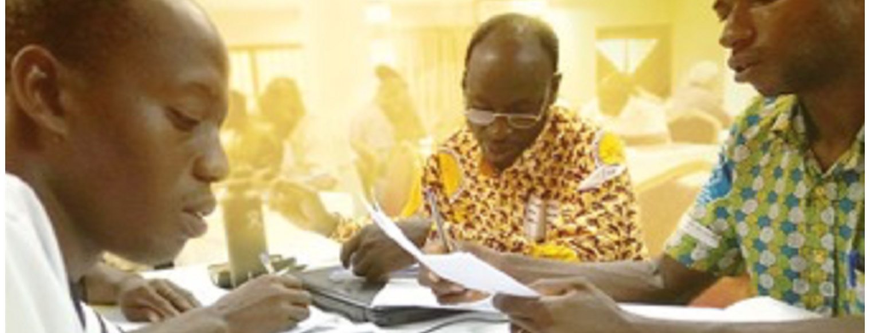
Do not withhold good from those who deserve it, when it is in your power to act. Do not say to your neighbor, "Go, and come again, and tomorrow I will give it,“ when you have the money with you (Prov. 3:27-28).
All Scripture taken from the English Unlocked Literal Bible (ULB), ©2017, 2022 Wycliffe Associates, Available at https://bibleineverylanguage.org/translations, licensed under the Creative Commons Attribution-ShareAlike 4.0 International License.
The English ULB is based on the unfoldingWord® Literal Text, CC BY-SA 4.0. The original work of the unfoldingWord® Literal Text is available at https://unfoldingword.bible/ult/.
Release Early,
Revise Often

Slide 2
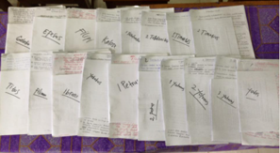
?
When should a translation be shared with the language community?
When the translators have made it
the best they can
at the time

Slide 3
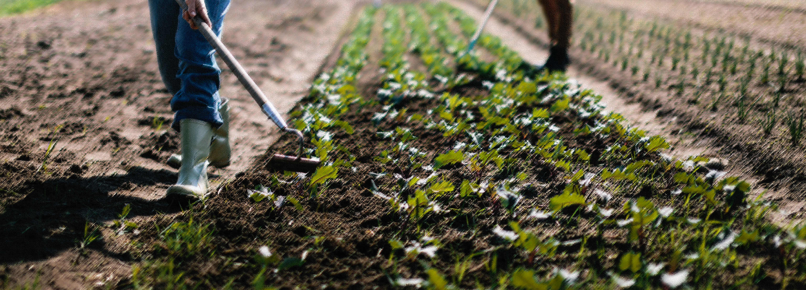
Ecclesiastes 11:2, 4
Share it with seven, even eight people, for you do not know what disasters are coming on the earth.
...⁴ He who watches the wind might not plant, and he who watches the clouds might not harvest

Slide 4
?

Slide 5
Feedback
Corrections
Improvements
Updates

Slide 6
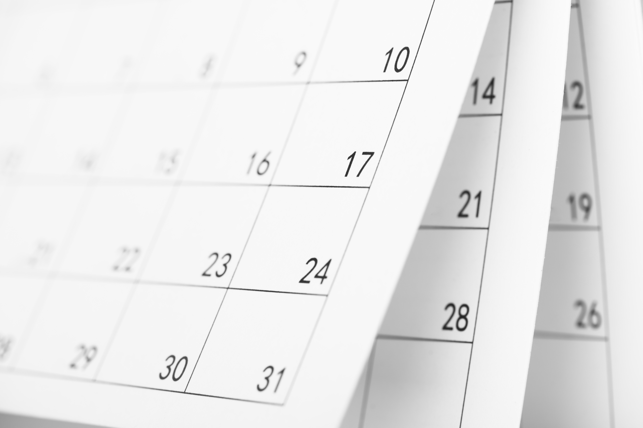
?
What could happen
if the team does not release early?
Language changes

